Slide 1
Premium Fuel Products Proposal For Euro Truck

Slide 2
Who we are?
Euro Truck is a logistics company that majors in goods and services delivery across Europe via their numerous and outstanding trucks.
These trucks are fuel powered. This has made Euro Truck one of the major client of Propel Forward Petrol Fuels.
These fuel products are not sustainable over a long period of time, because of the emissions they produce.

Slide 3
Objectives
The Objective of this project would be to Propose a new deal highlighting the financial, operational, and sustainability benefits of high grading their energy portfolio. It would also include a 5-year plan to help Euro Truck on their decarbonisation journey.

Slide 4
ANALYSIS

Slide 5
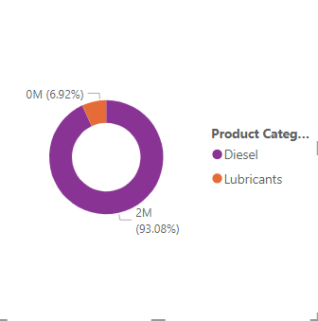
Euro Truck 2022 in pictures | Products volumes
A Doughnut chart of the total volume of product consumed by Euro truck in 2022. Lubricants made up 6.92%, while diesel made up 93.08% of their portfolio. Euro Truck is a big consumer of diesel.

Slide 6
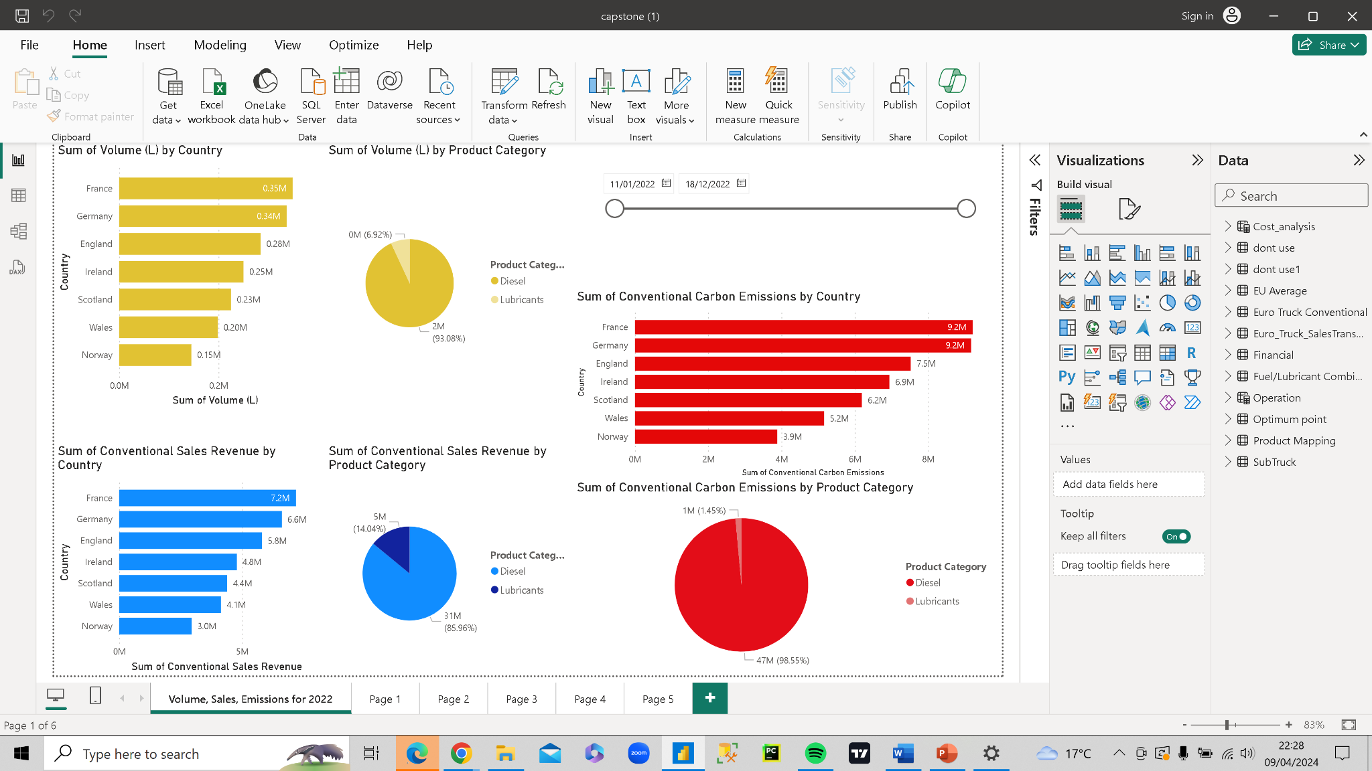
Report of 2022 volume,sales and emissions
Relationship between sales and emissions are directly proportional.

Slide 7
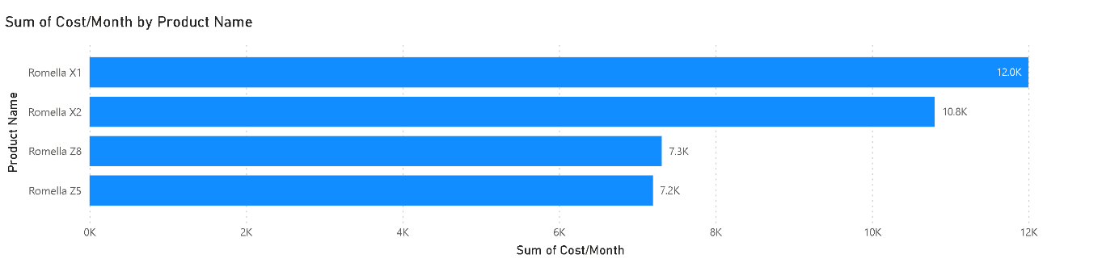
Financial Benefit
Given the data provided we found out on average, each truck would travel 30,000 KM a month. Therefore we worked out how much it would cost to run the trucks a month, by changing to different lubricants.
1 Products that perform reliably, last longer, or offer superior functionality can increase customer satisfaction and potentially command a premium price point.
2 The money saved could be used for upskilling the workforce and enhancing productivity, innovation, and overall company capabilities.
3 Although the premium products are expensive, the long-term financial benefits outweigh the initial investment cost
4 Offering premium products can enhance Euro TrucK image and reputation. This can attract new customers foster stronger customer loyalty and increase sales.
5.Financial Reserves to help the company weather economic downturns or unexpected expenses.

Slide 8
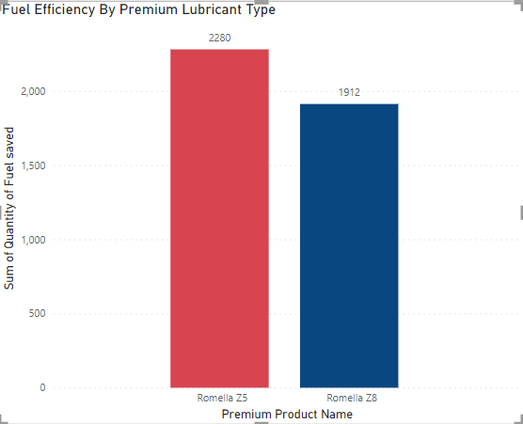
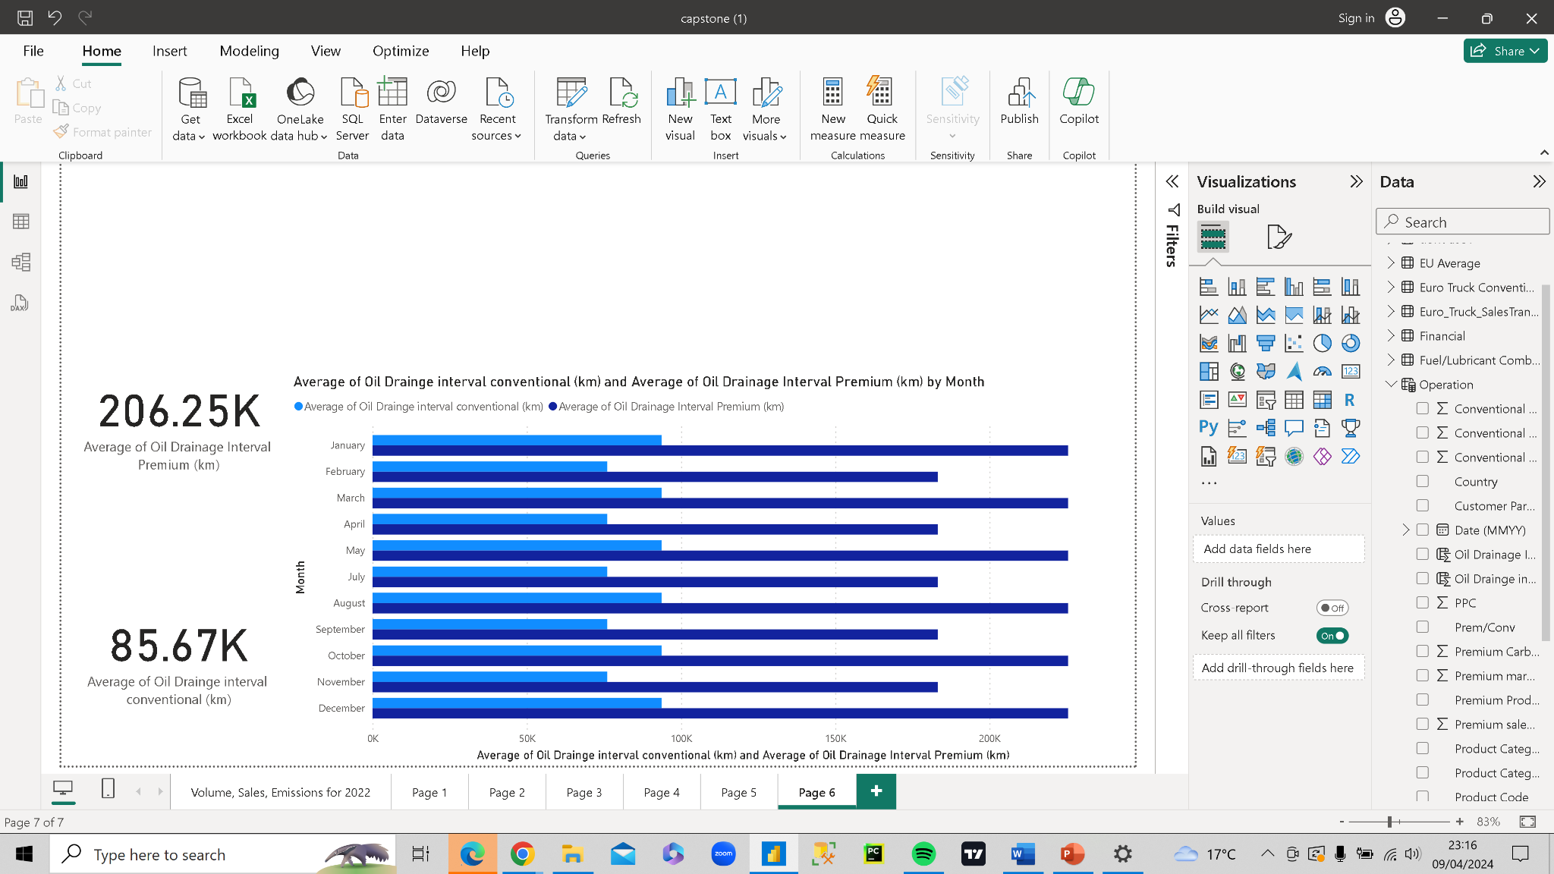
Operational Benefit
From the data provided, conventional lubricants have 0% fuel efficiency. Meaning that Euro Truck current Lubricant Portfolio is not making them save on Fuel (Diesel).
*The plot below shows the fuel efficiency that Euro Truck would have if every of their conventional lubricants were to be replaced by their equivalent premium alternatives.* 1.There would be increase in productivity.2 Reduced oil frequency change 3. Extend the life span of the engines.4. Reduce repair costs due to high quality lubricant usage.
T

Slide 9
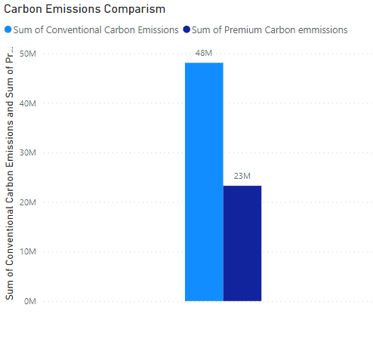
Sustainability Benefits
Reducing carbon emissions will significantly contribute to mitigating climate change by lessening the greenhouse effect.
Decreased carbon emissions lead to improved air quality, reducing pollution-related health issues and respiratory diseases.
Preservation of natural habitats and biodiversity through reduced environmental degradation.
Enhanced sustainability and resilience of ecosystems, ensuring a healthier planet for future generations.

Slide 10

Optimum Point

Slide 11
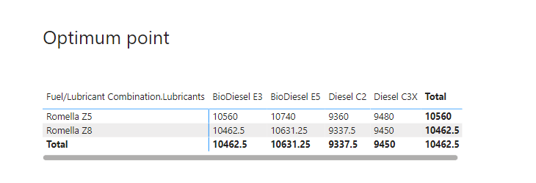

Slide 12
5 Year Proposal Plan
The Pilot Phase (year 1 -2 )
Replace a fraction of the conventional products with premium products.
The Expansion Stage (Year 2-3)
Expansion of premium product usage to a larger portion of Euro Trucks' fleet.
The Optimization phase (year 5) Full-scale implementation of premium fuels and lubricants across Euro Trucks' entire fleet.
Fine-tuning of operations to maximize efficiency and sustainability.

Slide 13


